Slide 1

Communities Trigger Emails
Community Migration 2012
Jillian Johannson
Casey Goddard
Judy Massuda
Notes:
Use a topic title slide each time a new person is presenting or a new topic is presented.

Slide 2
Communities Trigger Emails
Welcome Email - The new member receives this email after joining the community platform (ex. https://www.mysears.com/register).
Discussion Post Email - The community member will receive this email if someone on the community response to their original discussion post.
General Promotional Email - All members of the community receive this email on when there is major promotion being launched. The cadence is decided by the Community managers.
Answer Network Email - The member will receive this email when someone opts in to help answer their questions in a particular category.

Slide 3
Welcome Email Wireframe
Header
Share Icons
Navigation
Dear Casey,
Body copy
Link - Join the Discussion
Title
Copy
Image
Links
Image
Links
Image
Links
Footer Copy
Footer Links
Legal Disclosure / Unsubscribe Links

Slide 4
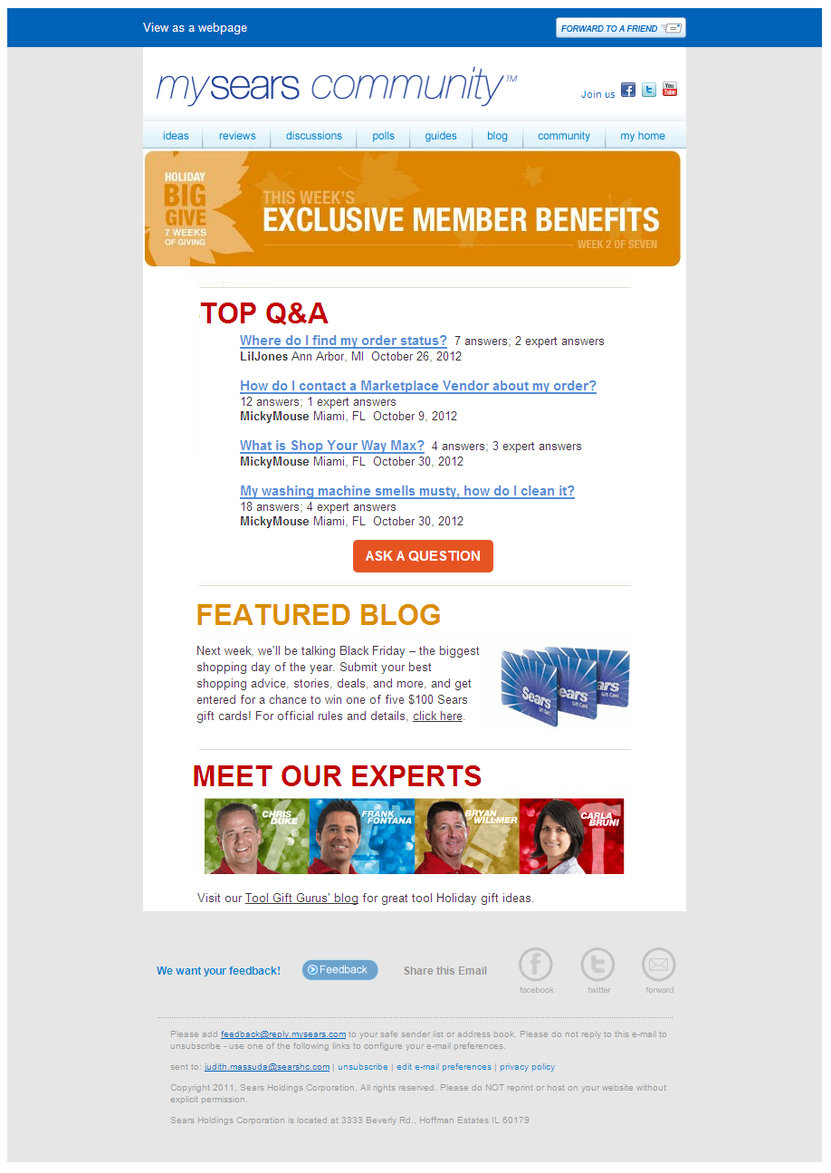
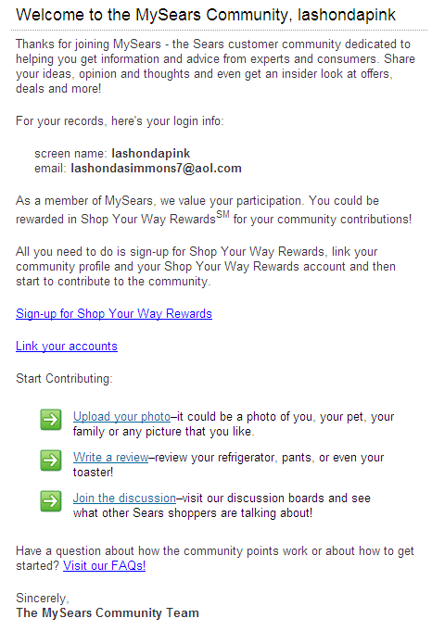
Welcome Email - Sample ONLY

Slide 5
New Discussion Email
Discussion Post Email Wireframe
Header
Share Icons
Navigation
Title - Discussion Update
Latest post in [Discussion Topic]
[Users Name] responded on Month, Date, Year
Body copy
Button Reply Now
View all topics in [Discussion Topic] >>
Footer Links
Legal Disclosure / Unsubscribe Links

Slide 6
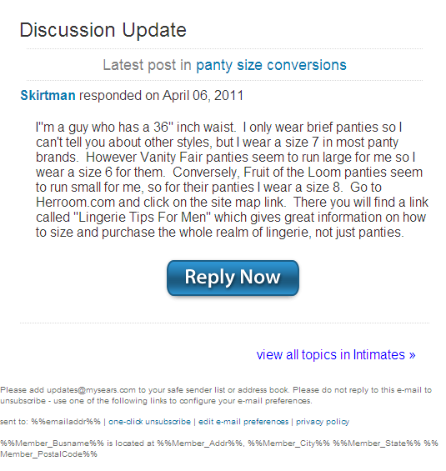
Category Digest Email
Discussion Post Email - Sample ONLY

Slide 7
Promotional Email Wireframe
Header
Share Icons
Navigation
Ad Unit
Clickable Button
Links
Feature Title
Image
Copy
Tips and Advice Title
Copy
Image
Links
Image
Links
Image
Links
Planning Title
Copy
Image
Image
Image
Link - Upload Picture
Links
Links
Links
What’s New - Title
Image
Copy
Copy
Links
Copy
Links
Copy
Links
Copy
Links
Title
Title
Copy
Copy
Links
Links
Image
Image
Title
Image
Copy
Links
Footer Links
Legal Disclosure / Unsubscribe Links

Slide 8
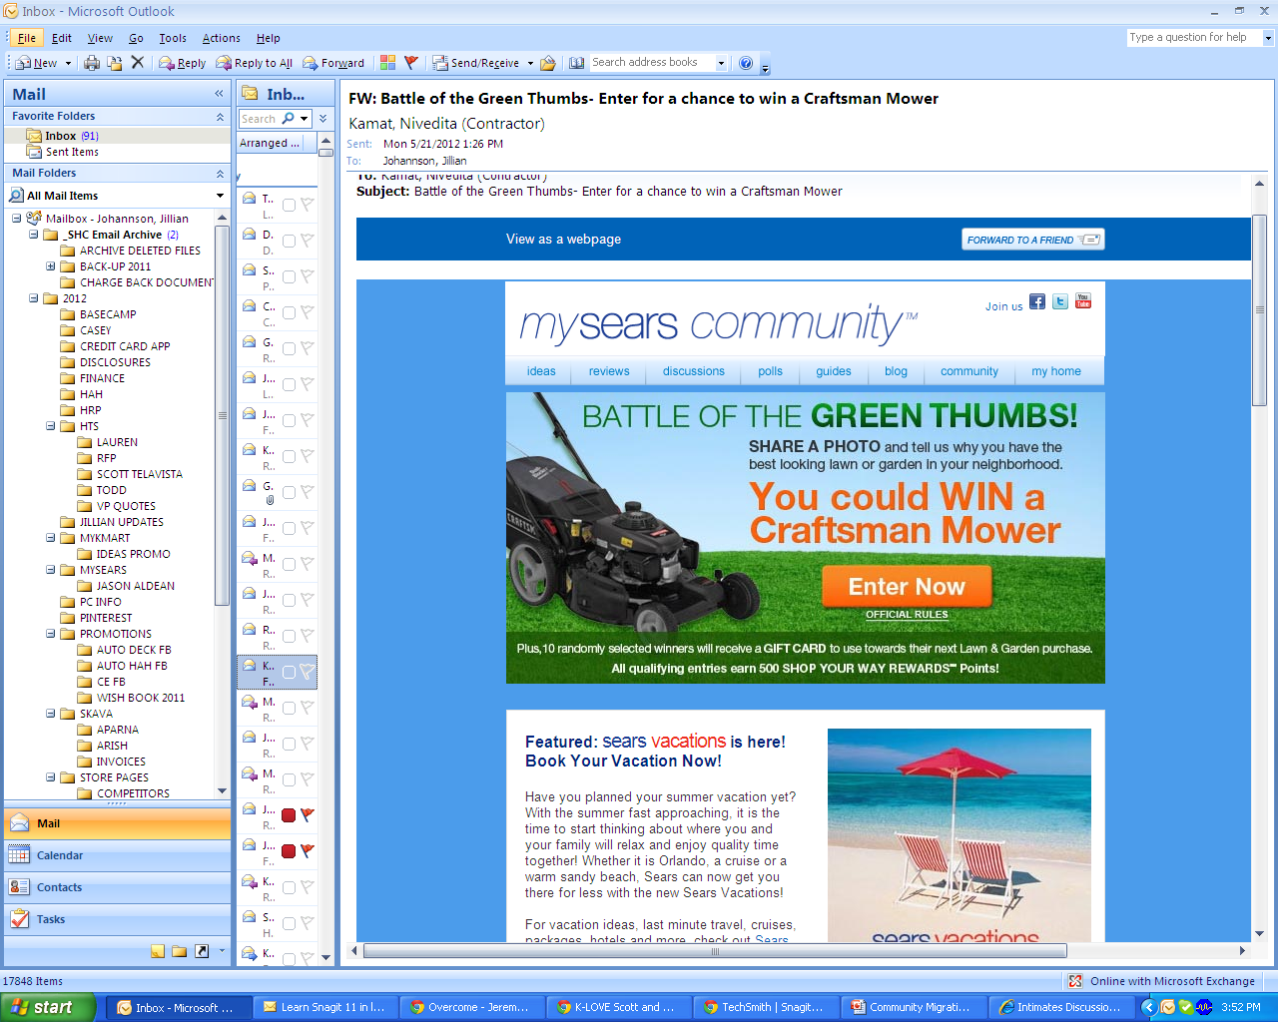
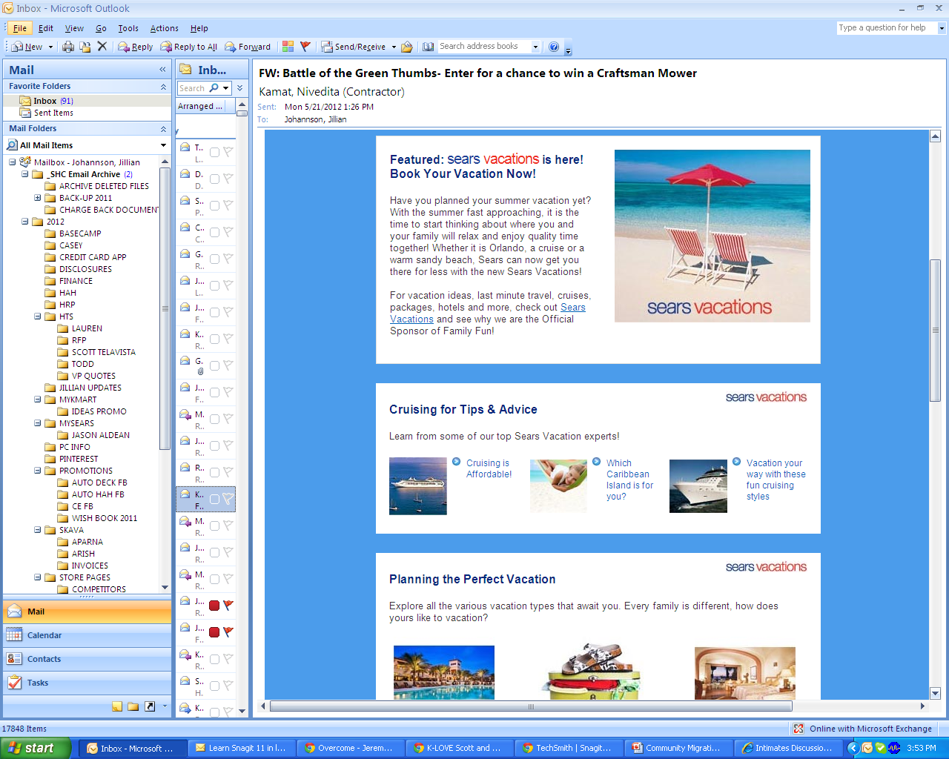
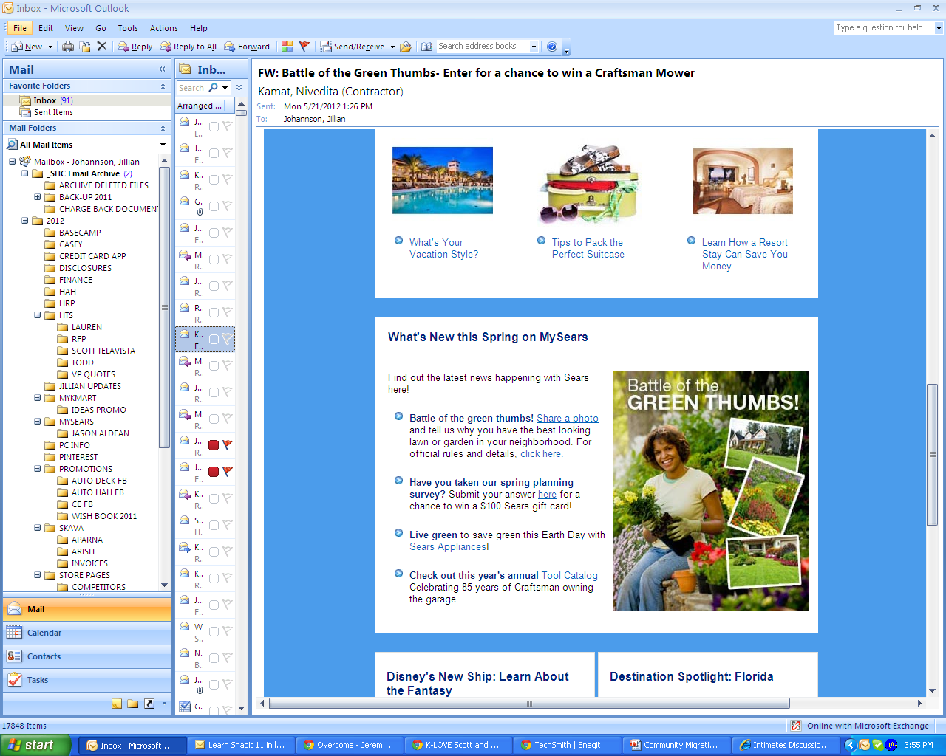
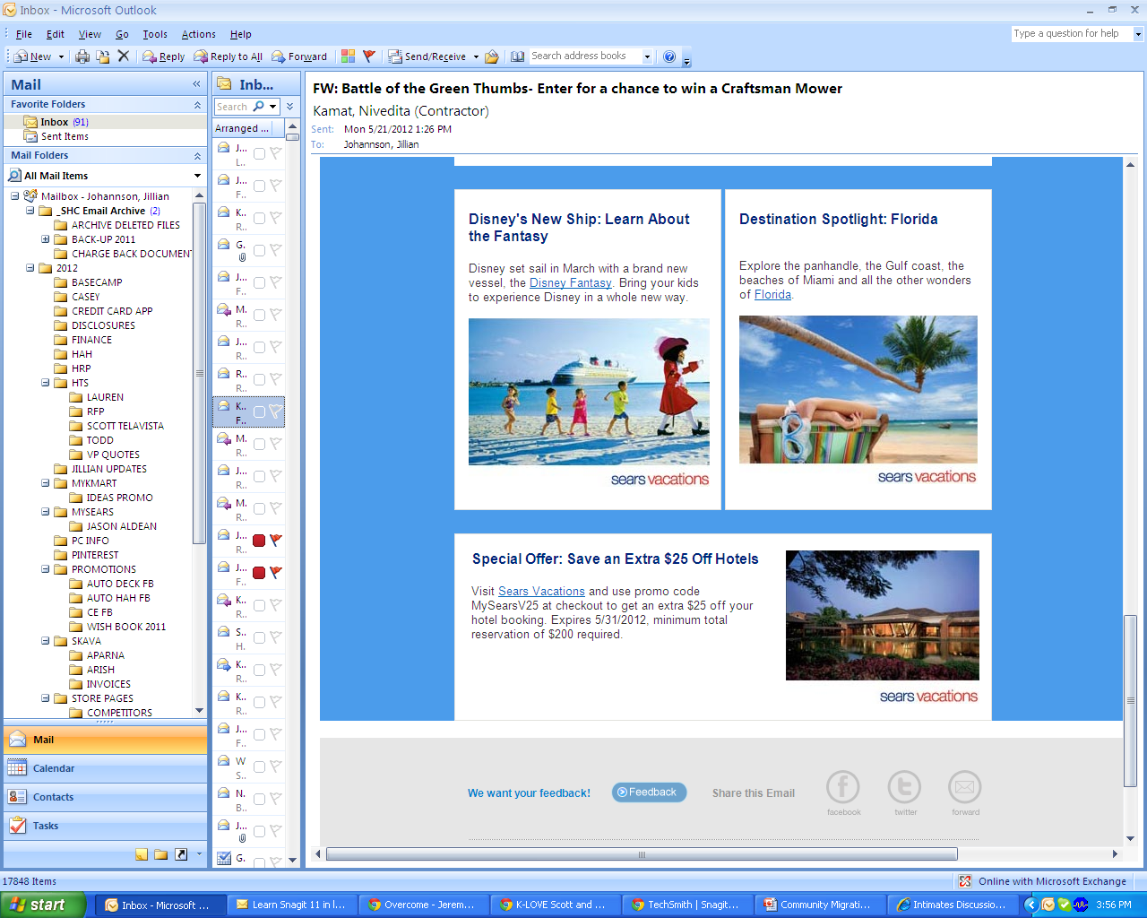
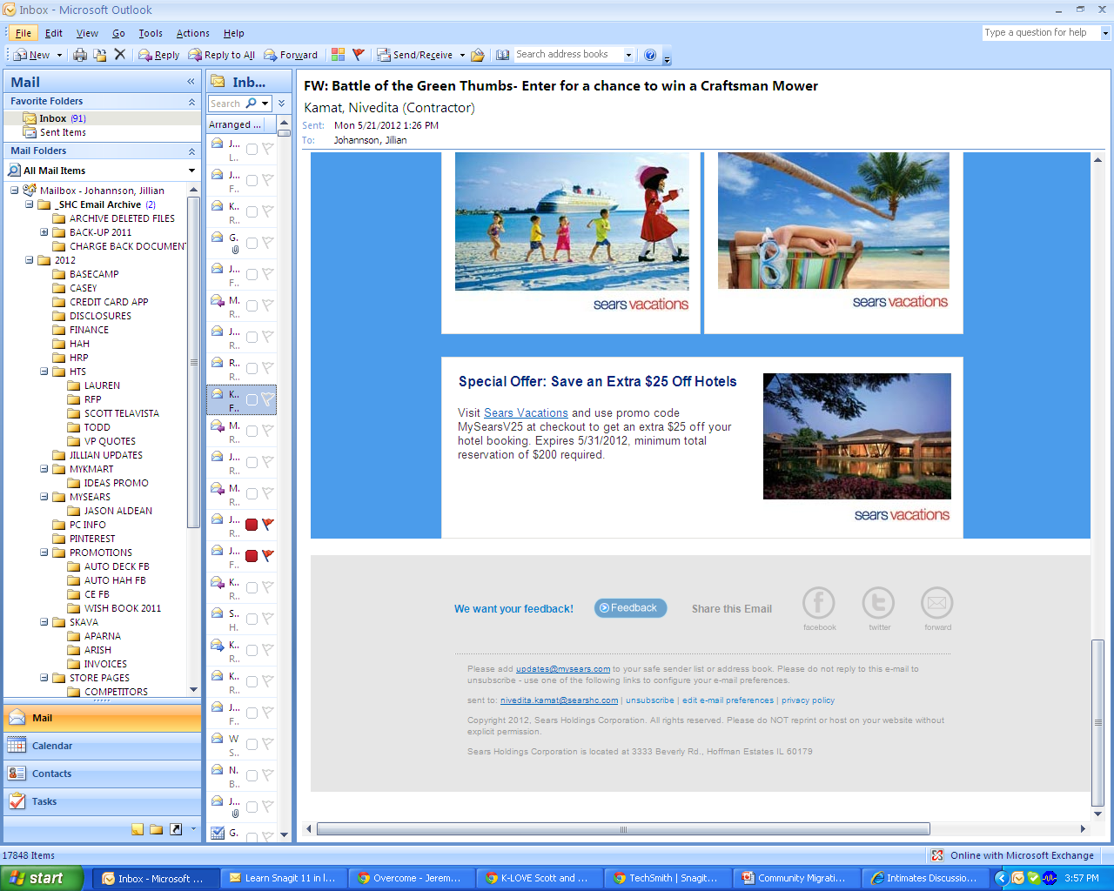
Promotional Emails
Promotional Email - Sample ONLY

Slide 9
Answer Network Email Wireframe
Header
Share Icons
Navigation
New Topic in Categories
Category Question Links COPY
Button Reply Now
Category Question Links COPY
Button Reply Now
Category Question Links COPY
Button Reply Now
Clickable -- Ad Unit
Clickable -- Ad Unit
Footer Links
Legal Disclosure / Unsubscribe Links

Slide 10
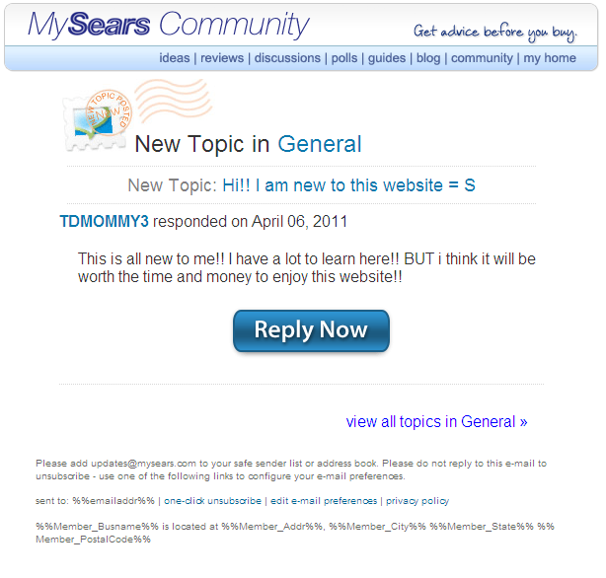
Network Answer Email - Sample ONLY

